Slide 1


Autonex AI
PAINT SHOP CONVEYOR SYSTEM SIMULATION
Devanshu Shivkumar Singh

Slide 2

Autonex AI
INTRODUCTION
  This project simulates a paint shop conveyor system used in an automotive manufacturing plant.
  The system consists of three sequential stations: Cleaning, Primer, and Painting.
  Using SimPy, the simulation models real-time car arrivals, machine constraints, queues, and processing times over one full 8-hour shift.
  The main goal is to analyze system performance, measure key metrics, and identify bottlenecks in the process.

Slide 3
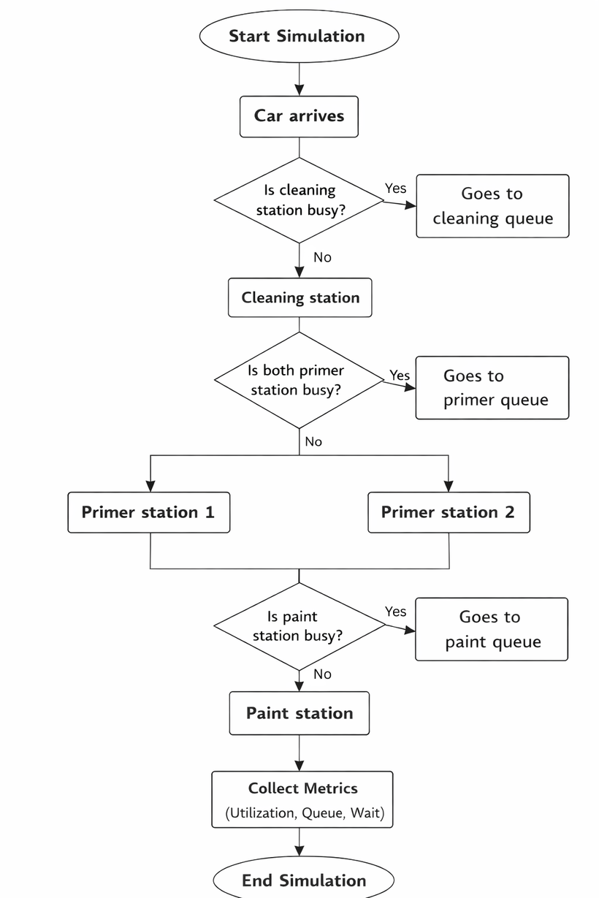
Autonex AI
SIMULATION MODEL
  Cars arrive and pass sequentially through the Cleaning, Primer, and Painting stations.
  If a station is busy, cars wait in the corresponding queue until processing is available.
  After completion, system metrics are collected to analyze performance and identify bottlenecks.

Slide 4
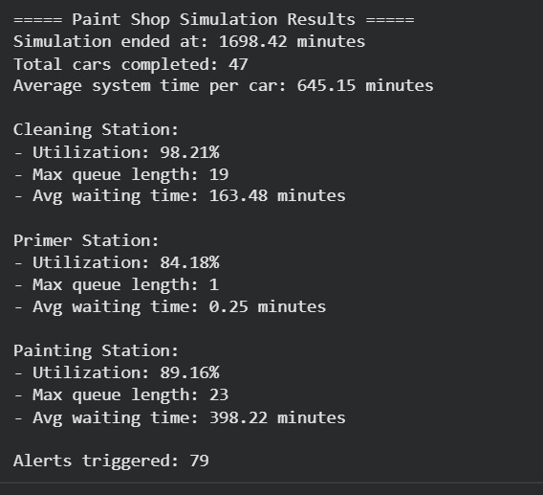
Autonex AI
RESULTS
1 Cleaning, 2 Primer, 1 Painting Station
  Cleaning Station: Operates near full utilization, causing cars to wait and queues to form at the entry stage.
  Primer Station: Two parallel machines allow smooth processing with minimal waiting and low congestion.
  Painting Station: Acts as the main bottleneck since only one car can be processed at a time, leading to long queues and higher waiting time.
  Overall Insight: System delays are mainly due to capacity limitations at single-machine stations, clearly indicating areas for optimization.

Slide 5
Autonex AI
CONCLUSION
  The simulation demonstrates that stations with limited capacity, especially single-machine stations, directly impact waiting times and overall system efficiency.
  Parallel processing, as implemented at the Primer station, proves effective in reducing queues and balancing workflow across the system.
  This simulation model serves as a useful tool to evaluate different machine configurations and arrival patterns, helping in data-driven decisions to improve throughput and reduce bottlenecks.

Slide 6
Autonex AI
THANK YOU!
FOR YOUR ATTENTION

